Slide 1
Object Oriented Programming Lecture-11.1
string buffer, string builder
Prof. Varsha Dange

Slide 2
StringBuffer Class in Java
string is fixed-length, immutable, and cannot be modified.
To overcome this, Java language introduced another class called StringBuffer.
Java StringBuffer class is used to create mutable (modifiable) String objects.
The StringBuffer class in Java is the same as String class except it is mutable i.e. it can be changed.
once we create a StringBuffer class object, we can perform any required changes in the object. i.e, its data can be modified.

Slide 3
StringBuffer Class in Java
That’s why StringBuffer class objects are mutable in Java.
It creates strings of flexible length that can be modified in terms of both length and content.
That’s why StringBuffer is more flexible than String.
Java StringBuffer class is thread-safe i.e. multiple threads cannot access it simultaneously.
So it is safe and will result in an order.
StringBuffer class is present in java.lang package.

Slide 4
Constructors of StringBuffer class in Java
StringBuffer class defines four constructors in Java. They are as follows:
1. StringBuffer(): Constructs a string buffer with no characters in it and an initial capacity of 16 characters. 2. StringBuffer(int size): Constructs a string buffer with no characters in it and the specified initial capacity.
3. StringBuffer(String str): Constructs a string buffer initialized to the contents of the specified string.
4. StringBuffer(CharSequence seq):It creates a string buffer with the same characters specified as the argument.

Slide 5
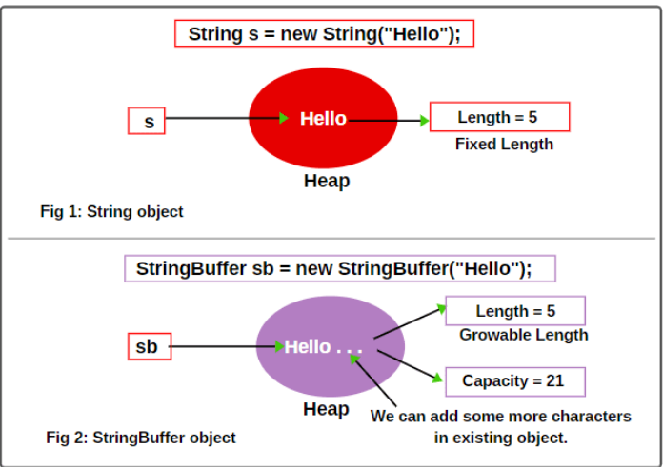
Length and Capacity in Java StringBuffer
Capacity: The total number of characters hold in the StringBuffer object is called capacity.
Length: The number of characters already present in the StringBuffer object is called length.

Slide 6


how to create StringBuffer object in Java
There are mainly three ways to create StringBuffer objects in Java.
First way:
The first way for creating a StringBuffer object is that first allocate the memory for the StringBuffer object by using the new operator and then store the string into it.
Here, we have created an empty StringBuffer object with a default initial capacity of 16 characters and not passing any string to it.
To store a string into it, we can use append() method like this.
Example

Slide 7
how to create StringBuffer object in Java
Now suppose 16 characters are completed. Can we add 17th character in the existing StringBuffer object?
Yes, if the StringBuffer object is full, still we can add 17th character to it.
Once the capacity of StringBuffer object is filled, a new StringBuffer object will be created with bigger capacity.
All the 16th characters will be copied plus 17th character will be added.
The reference variable sb will point to the new object and the old object by default will be gone to the garbage collector.
But these total things will happen internally.
If the number of character increases from its current capacity, it increases the capacity by (oldCapacity*2)+2.
For example if your current capacity is 16, it will be (16*2)+2=34.
Example

Slide 8
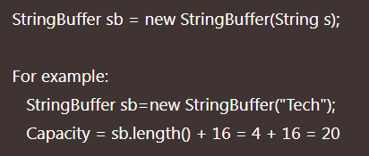
how to create StringBuffer object in Java
Second way:
We can create an object of StringBuffer class by using the new operator and pass the string to the object.
Example

Slide 9
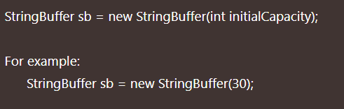
how to create StringBuffer object in Java
Third way:
We can also create an empty StringBuffer object by declaring a size as an argument for storing characters.
Here, an empty StringBuffer object has been created with a capacity for storing 30 characters.
But it is also possible to store more than 30 characters in this object because StringBuffer is mutable and can expand dynamically in the memory.
Forth way: using charsequence
Example

Slide 10
Methods of StringBuffer class in Java
Method | Description
append(String s) | It is used to append the specified string with existing string.
insert(int offset, String s) | It is used to insert the specified string with existing string at the specified position. Example
replace(int startIndex, int endIndex, String str) | It is used to replace the string from specified startIndex and endIndex. Example
delete(int startIndex, int endIndex) | It is used to delete the string from specified startIndex and endIndex. Example
reverse() | is used to reverse the string. Example
capacity() | It is used to return the current capacity.
ensureCapacity(int minimumCapacity) | It ensures that the given capacity is the minimum to the current capacity. If it is greater than the current capacity, it increases the capacity by (oldcapacity*2)+2. For example if your current capacity is 16, it will be (16*2)+2=34. Example
charAt(int index) | It is used to return the character at the specified index.
length() | It is used to return the length of the string i.e. total number of characters.
substring(int beginIndex, int endIndex) | It is used to return the substring from the specified beginIndex and endIndex.

Slide 11
StringBuilder class in Java
Java StringBuilder class is used to create mutable (modifiable) String.
The StringBuilder in Java represents a mutable sequence of characters.
The function of StringBuilder is very much similar to the StringBuffer class, as both of them provide an alternative to String Class by making a mutable sequence of characters.
the StringBuilder class differs from the StringBuffer class on the basis of synchronization.
The StringBuilder class provides no guarantee of synchronization whereas the StringBuffer class does.

Slide 12
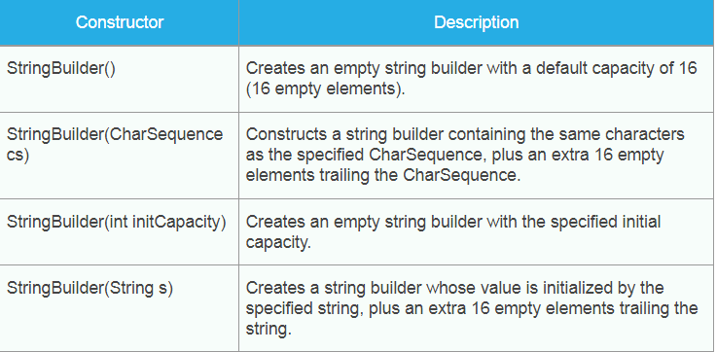
StringBuilder class in Java
the StringBuffer is suitable choice in multi threading but StringBuilder is not safe for multi threading .
StringBuilder is faster than StringBuffer.

Slide 13
Methods of StringBuilder class in Java
Method | Description
append(String s) | It is used to append the specified string with existing string. Example
insert(int offset, String s) | It is used to insert the specified string with this string at the specified position. Example
replace(int startIndex, int endIndex, String str) | It is used to replace the string from specified startIndex and endIndex. Example
delete(int startIndex, int endIndex) | It is used to delete the string from specified startIndex and endIndex. Example
reverse() | is used to reverse the string. Example
capacity() | It is used to return the current capacity. Example
ensureCapacity(int minimumCapacity) | It ensures that the given capacity is the minimum to the current capacity. If it is greater than the current capacity, it increases the capacity by (oldcapacity*2)+2. For example if your current capacity is 16, it will be (16*2)+2=34. Example
charAt(int index) | It is used to return the character at the specified position. Example
length() | It is used to return the length of the string i.e. total number of characters. Example
substring(int beginIndex, int endIndex) | It is used to return the substring from the specified beginIndex and endIndex.

Slide 14
Methods of StringBuilder class in Java
Method | Description
int indexOf(String str) | This method will return the index where the first instance of the specified string occurs. Example
int lastIndexOf(String str) | It will return the index where the specified string occurs the last. Example
Void trimToSize() | It will attempt to reduce the size of the StringBuilder. Example
StringBuilder deleteCharAt(int index): | This method removes the char at the specified position in this sequence. Example

Slide 15
Difference between String and StringBuffer
String | StringBuffer
The String class is immutable. | The StringBuffer class is mutable.
String is slow and consumes more memory when we concatenate too many strings because every time it creates new instance. | StringBuffer is fast and consumes less memory when we concatenate t strings.
String class overrides the equals() method of Object class. So you can compare the contents of two strings by equals() method. | StringBuffer class doesn't override the equals() method of Object class.
String class is slower while performing concatenation operation. | StringBuffer class is faster while performing concatenation operation.
String class uses String constant pool and heap memory area | StringBuffer uses Heap memory
Used when data is not get changed | Used when data get changed frequently

Slide 16
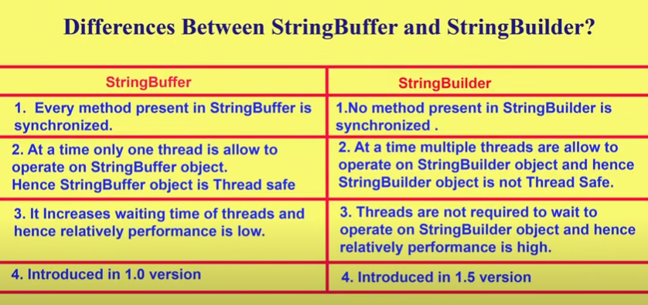
Difference between StringBuffer and StringBuilder
StringBuffer | StringBuilder
StringBuffer operations are thread-safe and synchronized | StringBuilder operations are not thread-safe are not-synchronized.
StringBuffer is safe to use in multi-threaded environment. | StringBuilder is not safe to used in a multi-threaded environment.
StringBuffer performance is slower when compared to StringBuilder | StringBuilder performance is faster when compared to StringBuffer
Syntax: StringBuffer var = new StringBuffer(str); | Syntax: StringBuilder var = new StringBuilder(str);

Slide 17
String Vs StringBuffer Vs StringBuilder
the differences between String, StringBuffer, and StringBuilder are based on the following two parameters:
Mutability
Performance

Slide 18
String Vs StringBuffer Vs StringBuilder
Mutability
Strings are immutable while StringBuffer and StringBuilder are mutable.
So, Strings cannot be changed when you use the String class; whereas Strings can change if you use the StringBuffer and StringBuilder class.
Example

Slide 19
String Vs StringBuffer Vs StringBuilder
Performance
StringBuilder is faster than StringBuffer as it offers no synchronization.
This is because no extra overhead needs to be added to the system and also does not slows down the processing.
Parameter | String | StringBuffer | StringBuilder
Storage | String Pool | Heap | Heap
Mutability | Immutable | Mutable | Mutable
Thread Safe | Not used in a threaded environment | Safe to used in multi-threaded environment | Not safe to used in multi-threaded environment
Performance | Slow | Slower than StringBuilder but faster than String | Faster than StringBuffer
Syntax | String var =“VIT”; String var=new String(“VIT”); | StringBuffer var = new StringBuffer(“VIT"); | StringBuilder var = new StringBuilder(“VIT");

Slide 20
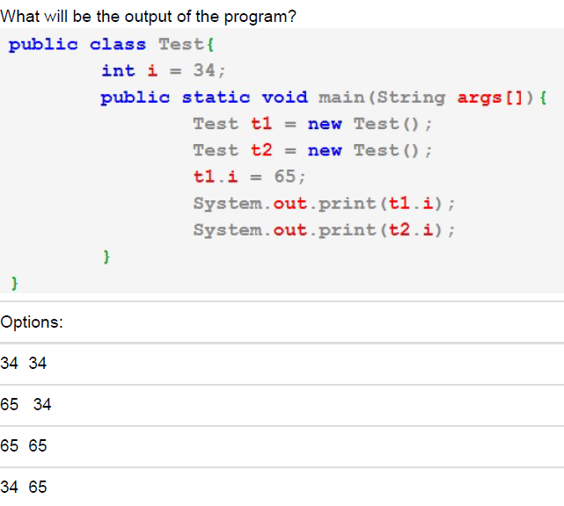
Questions
65 34

Slide 21
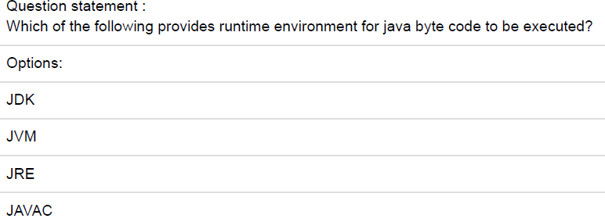
Questions
JVM

Slide 22
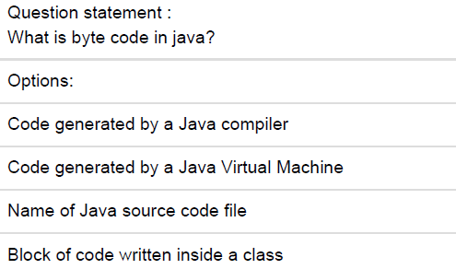
Questions
Code generated by a Java compiler

Slide 23
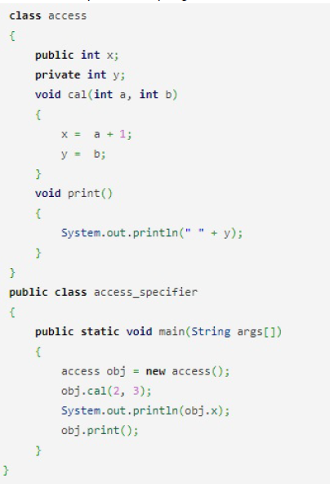
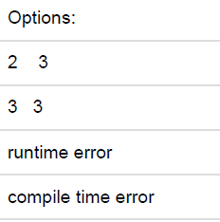
Questions
3 3

Slide 24
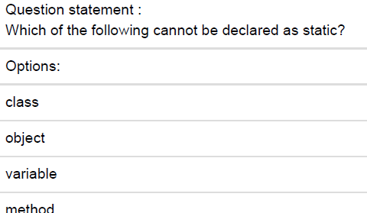
Questions
Object

Slide 25
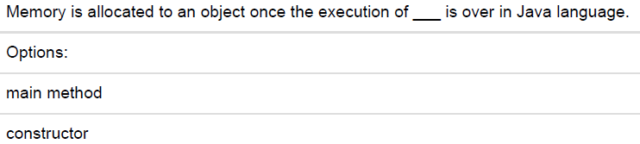

Questions
Constructor

Slide 26
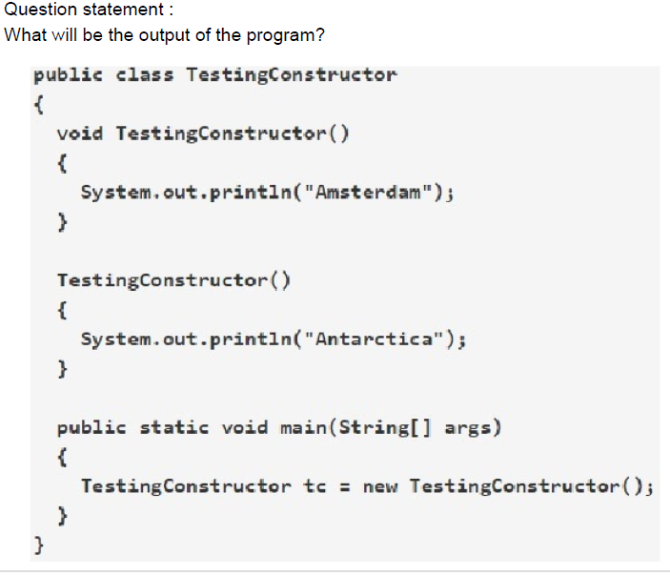
Questions
Antarctica

Slide 27
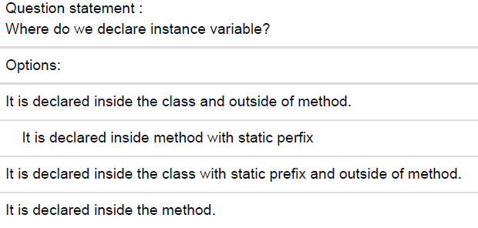
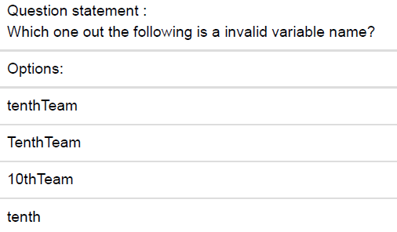
Questions
It is declared inside the class and outside of method.
10thTeam

Slide 28
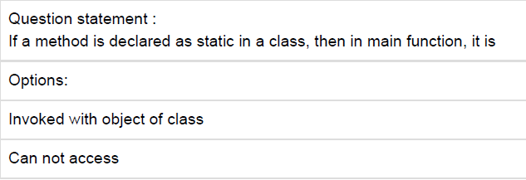

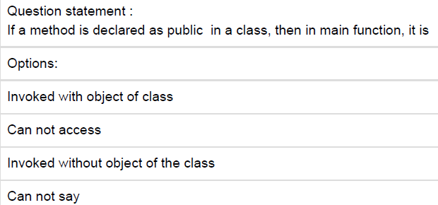
Questions
Invoked without object of the class
Invoked with object of class

Slide 29
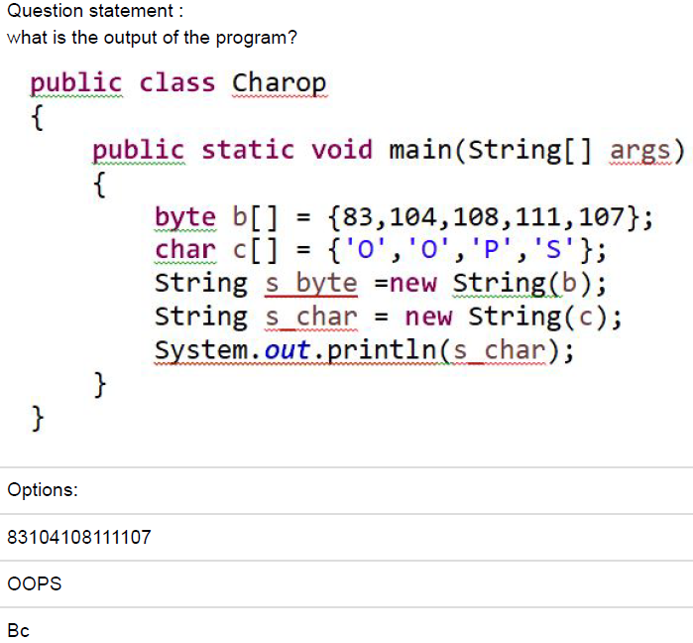
Questions
OOPS

Slide 30
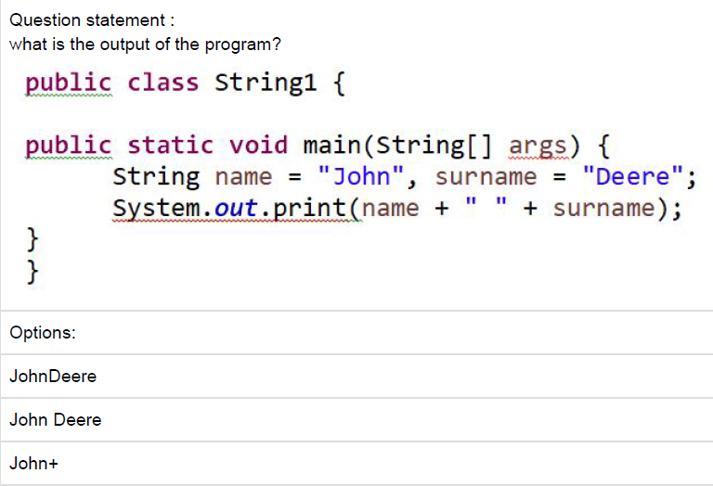
Questions
John Deere

Slide 31
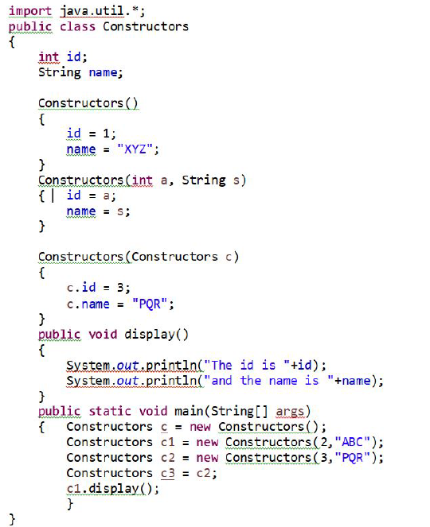
Questions
The id is 2 and the name is ABC

Slide 32
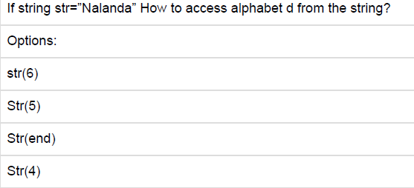
Questions
Str(5)

Slide 33
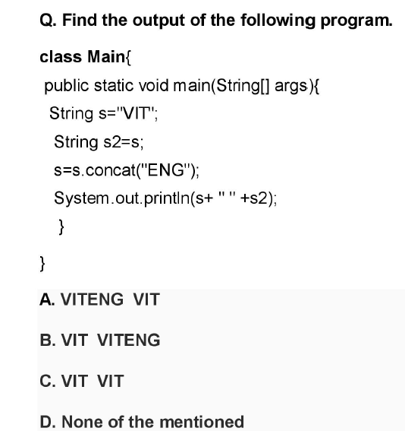
Questions
A

Slide 34
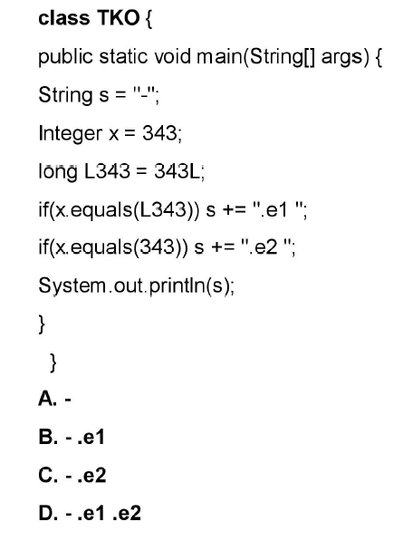
Questions
c

Slide 35
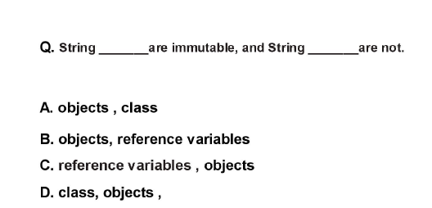
Questions
B

Slide 36
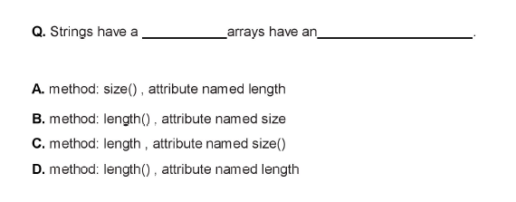
Questions
B
D

Slide 37
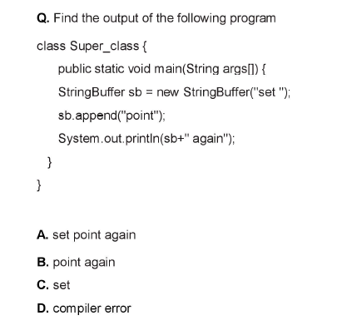
Questions
A

Slide 38
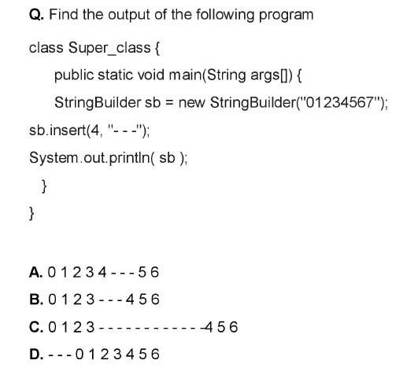
Questions
B
7
7
7

Slide 39
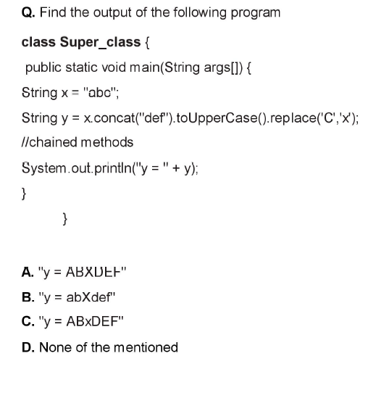
Questions
C

Slide 40
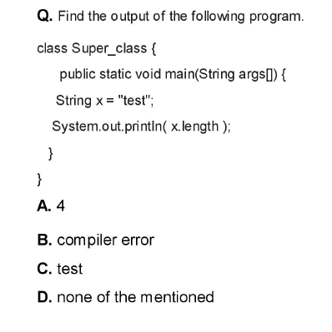
Questions
B

Slide 41
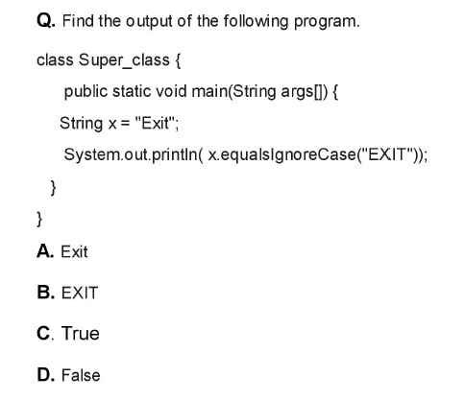
Questions
C

